Slide 1
UNIT - 1

Slide 2
Topics:
Review of p-n junction diode
Characteristics, parameters and AC equivalent circuit
Half-wave diode Rectifier, Ripple factor
Full-wave diode rectifier
Other full-wave circuits
Breakdown diodes and their applications in power supply circuits.

Slide 3
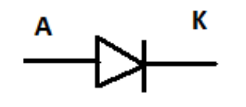
PN JUNCTION DIODE

Slide 4
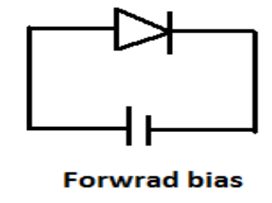
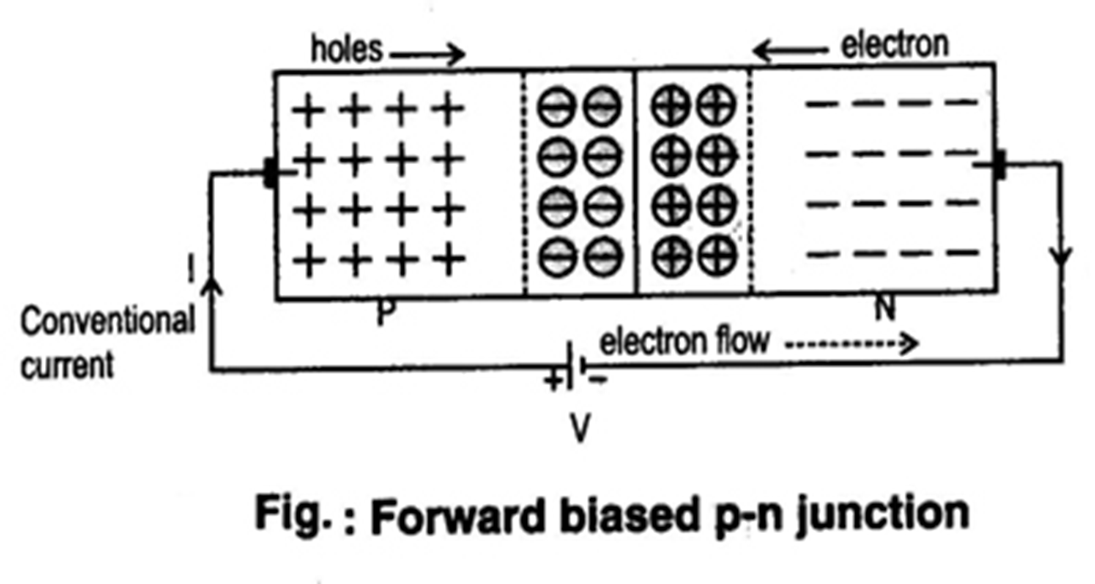
Forward bias

Slide 5
Forward Bias
PN junction is forward biased when a voltage is applied positive to the P side and negative to the N side
Depletion region decreases.
A majority charge carrier current (IF) flows across a forward biased junction
The junction forward characteristics is the Graph of VF versus IF
Forward voltage drop is for si = 0.7,
Ge =0.3

Slide 6
Reverse Bias
A pn junction is Reverse Biased when a positive voltage is applied to the n-side and negative to p-side.
Depletion region increases
A small minority charge carrier current IR flows across RB junction
The reverse saturation current Io tends to be constant regardless of the reverse bias voltage VR

Slide 7
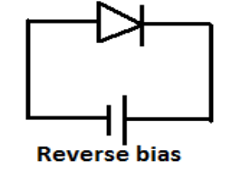
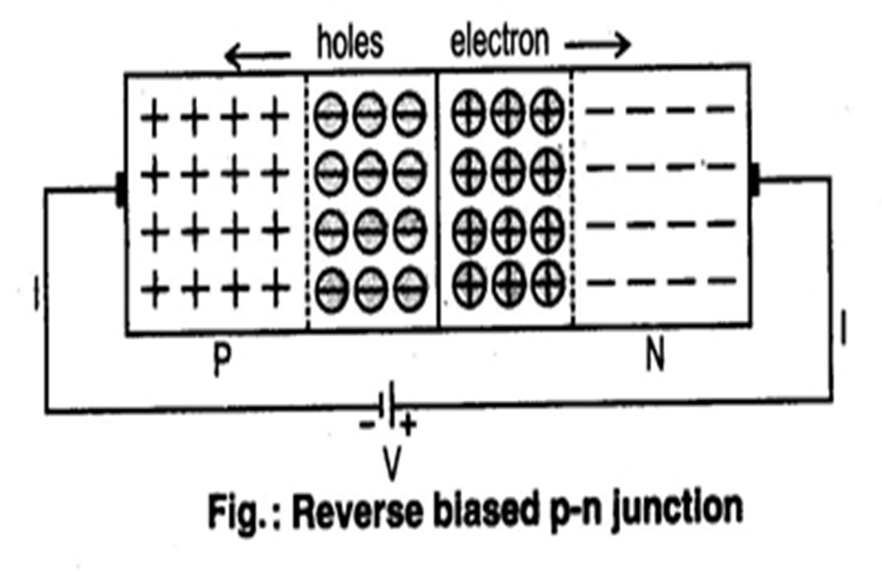
Reverse bias

Slide 8
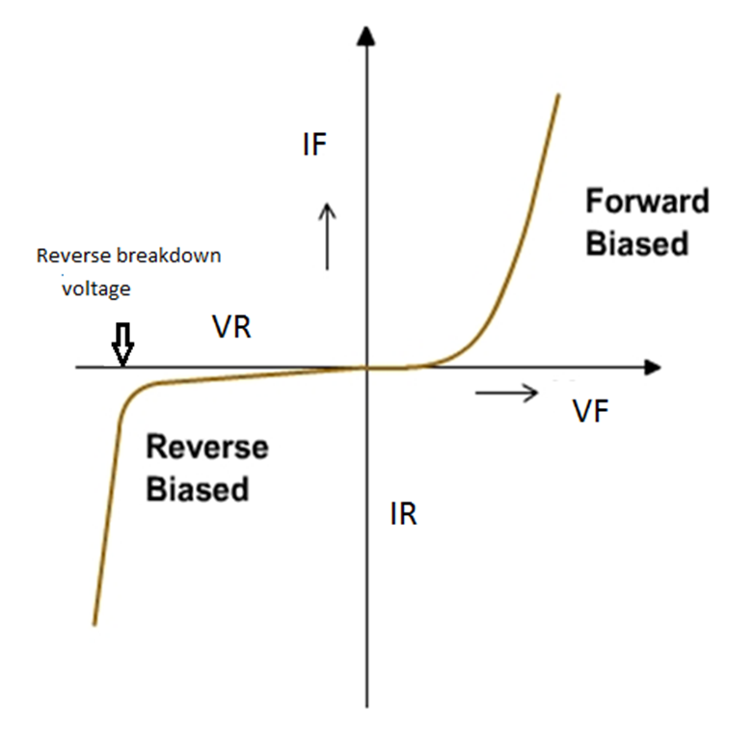
Forward and Reverse characteristics of
PN junction diode

Slide 9
PN junction diode parameters
VF : Forward voltage of a diode
IF : Forward Current of a diode
VR: Reverse Voltage of a diode
IR : Reverse current of a diode

Slide 10
Important parameters
Breakdown Voltage: It is the reverse voltage at which pn junction breaks down with sudden rise in reverse current.
Knee Voltage: It is the forward voltage at which the current through the junction starts to increase rapidly.

Slide 11
Static and Dynamic Resistance
Static Resistance : It is the constant resistance or DC resistance of the diode at a particular constant forward current.
Dynamic Resistance : It is the resistance offered to changing levels of forward voltage. ( Also known as incremental resistance or ac resistance)

Slide 12
Shockley equation
( or )
( Diode Junction currents and voltages)

Slide 13
The equation relating pn junction current and voltage levels is called the shockley equation.
I_{D} = I₀(e^{VD/ηVT} – 1)
I_{D} is the junction current through the diode,
I₀ is the reverse saturation current
V_{D} is the applied biasing voltage (junction voltage).
V_{T} is the thermal equivalent voltage and is approximately 26 mV at room temperature. The equation to find V_{T} at various temperatures is:
V_{T} = kT
q
k = 1.38 x 10⁻²³ J/K T = temperature in Kelvin q= 1.6 x 10⁻¹⁹ C
η is the emission coefficient for the diode.
For a silicon diode η is around 2 (low currents )
For germanium η is 1. ( higher currents)

Slide 14
RECTIFIERS
A device which is capable of converting an AC waveform into unidirectional (dc) waveform called as rectifier.
Rectifiers can be classified as
Half wave rectifier
Full wave rectifier:
Center tap full wave rectifier(2 diodes)
Bridge rectifier (4 diodes)

Slide 15
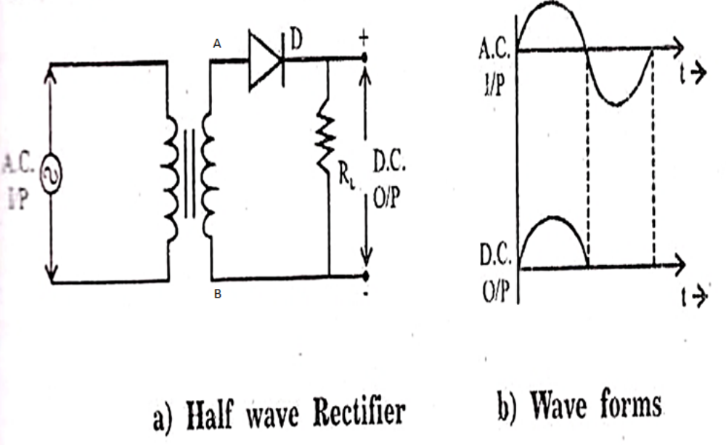
Half wave rectifier

Slide 16
Working..
During positive half cycle of input signal end A becomes positive with respect to end B.
This makes the diode forward biased. hence it conducts current.
During negative half cycle of input signal end A becomes negative with respect to end B.
This makes the diode reverse biased. hence it conducts no current.
Thus current flows through diode during positive half cycle only. this same current flows through load resistor.

Slide 17
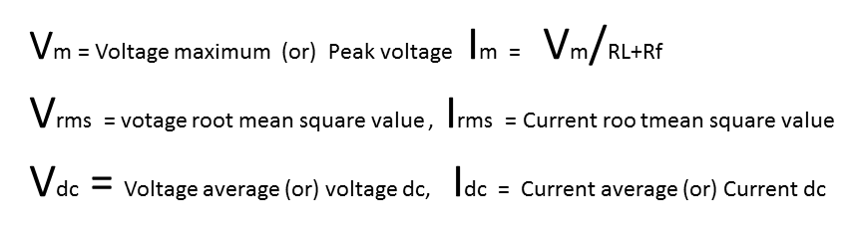
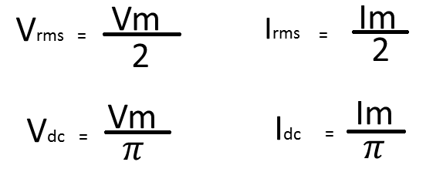
Half wave Rectifier

Slide 18
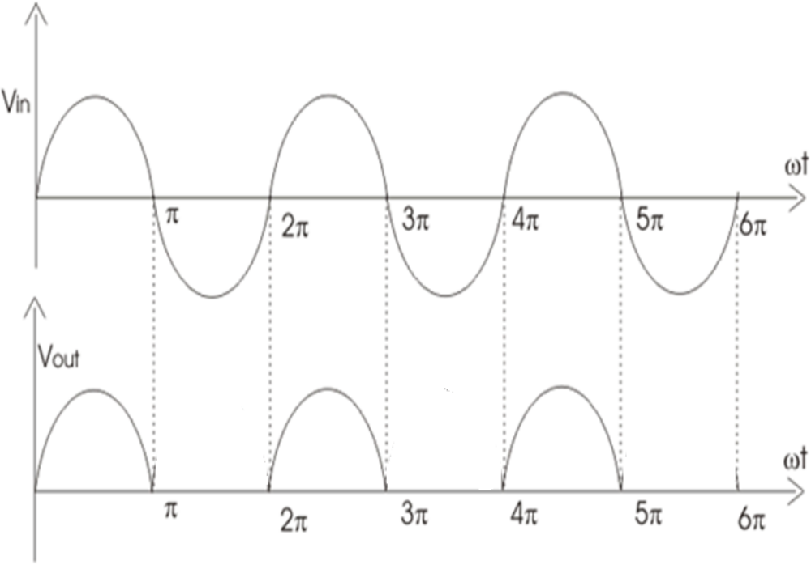
Half wave rectifier

Slide 19
Full wave Rectifier

Slide 20
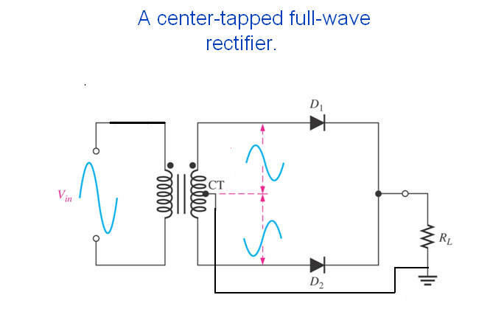

Slide 21
Full-wave Rectifier
The full-wave rectifier circuit uses two diodes, and its input voltage is supplied from a transformer with a centre-tapped secondary winding.
The circuit is combination of two half-wave rectifier circuits, each supplied one half of the transformer secondary.
When the transformer output voltage is positive at the top, the anode of the D1is positive, and the centre tap of the transformer is connected to the cathode of D1 by RL

Slide 22
Load current (IL) flows from the top of the transformer secondary through D1,throuth RL from top to bottom, and back to the transformer secondary centre tap.
During this time, the polarity of the voltage from the bottom half of the transformer secondary caused diode D2 to be reverse-biased,

Slide 23
During the negative half-cycle of the transformer output, the polarity of the transformer secondary voltage caused D1 to be reverse-biased and D2 to be forward-biased .IL flows from the bottom terminal of the transformer secondary through diode D2, through RL from top to bottom, and back to the transformer centre tap.
The output waveform is the combination of the two half-cycles, that is a continuous series of positive half cycles of sinusoidal waveform. this is also called positive full-wave rectification.

Slide 24
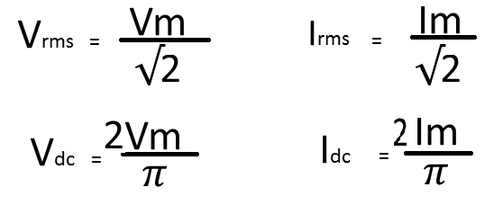
Full wave Rectifier

Slide 25
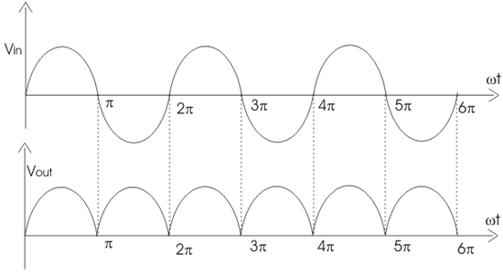
Out put waveform of full wave Rectifier

Slide 26
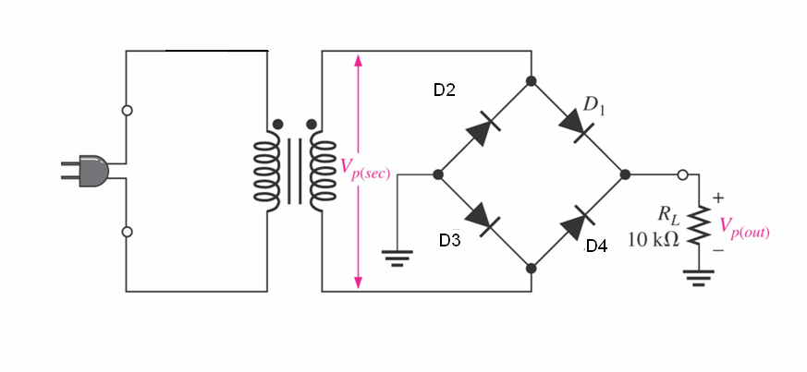
Full wave Bridge Rectifier

Slide 27
Bridge Rectifier
The centre-tapped transformer used for the full wave rectification is more expensive and requires more space than additional diodes.
So the bridge rectifier is the circuit most frequently used for full-wave rectification.
The bridge rectifier circuit consist of four diodes connected .diodes D1 and D2 are series-connected. and D3 and D4 are series connected

Slide 28
The ac input terminals are connected at the junction of D1 and D2 and the junction of D3 and D4.
The positive output terminal is at the cathodes of D1 and D4 and negative output is at the anodes of D2 and D3
During positive half cycle of input voltage, diodes d1 and d4 are forward biased and load current flows ,
During negative half cycle of input voltage diodes d3 and d4 are forward biased and load current flows,

Slide 29
Full wave Rectifier (Bridge)

Slide 30
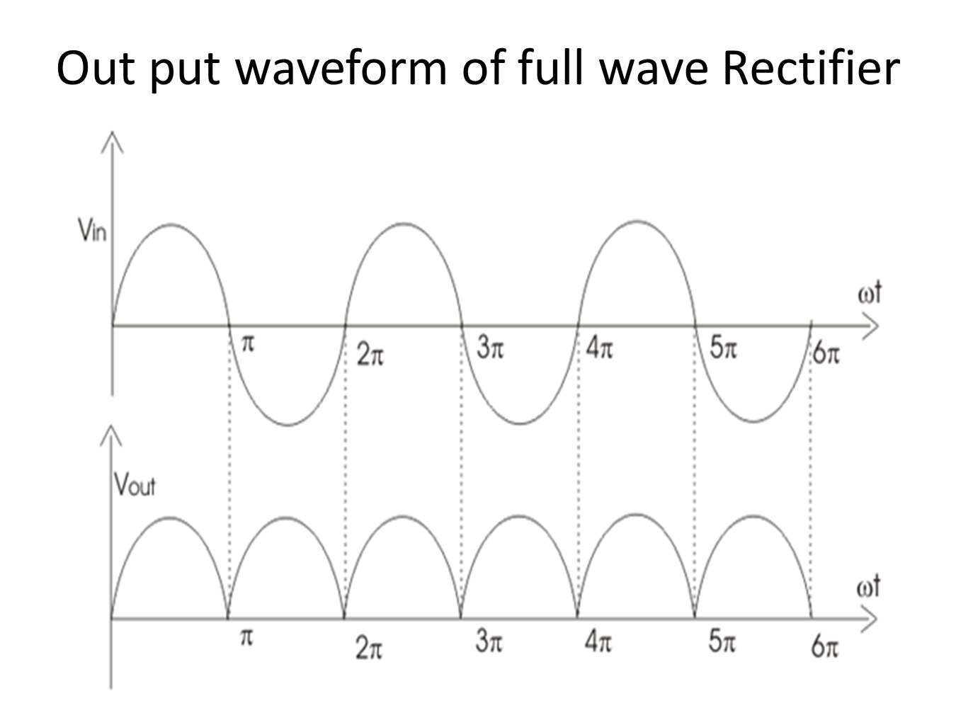

Slide 31
Peak Inverse Voltage (PIV)
Peak inverse voltage (PIV) : It is the maximum Reverse voltage across a diode when diode is Reverse biased
Half-wave rectifier: Vm
Full -wave rectifier ( center taped) : 2 Vm
Full wave rectifier (Bridge) : Vm

Slide 32
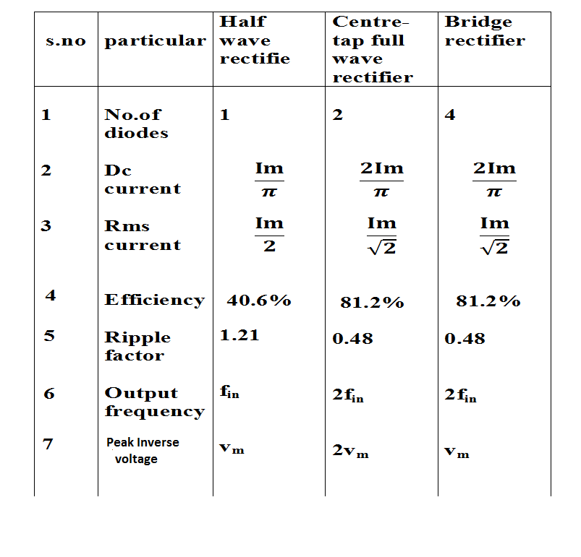
Comparison of Rectifiers

Slide 33
Break down Diodes

Slide 34
Zener diode symbol
A K

Slide 35
When the reverse voltage reaches breakdown voltage in normal PN junction diode, the current through the junction and the power dissipated at the junction will be high. Such operation is destructive and diode gets damaged

Slide 36
If the diode is heavily doped:
Depletion layer will be thin
The break down occurs at the lower voltages.
The break down or Zener voltage depends upon the amount of doping.

Slide 37
Zener and Avalanche breakdown
There are two mechanisms that cause breakdown in reverse biased PN junction
Zener break down
Avalanche breakdown

Slide 38
Zener breakdown
Zener diode is heavily doped than ordinary diode, with a very narrow depletion region.
The electric field strength (Volts/width) produced by a reverse bias voltage can be very high.
The high intensity electric field caused electrons to break away from their atoms, this is termed as ionization by electric field also called zener break down.
Zener breakdown usually occurs with reverse bias voltage less than 5V

Slide 39
Avalanche breakdown
The electrons in the reverse saturation current can be given sufficient energy to cause other electrons to break free when they strike atoms with in the depletion region, this is termed as ionization by collision.
The released in this way collide with other atoms to produce more free electrons in an avalanche effect
Avalanche breakdown is normally produced by reverse voltage level above 5v

Slide 40
Zener and Avalanche are two different types of breakdown. The name zener diode is commonly applied to all breakdown diodes

Slide 41
Zener diode
Characteristics

Slide 42
Zener diode is always connected in reverse bias condition
A zener diode has sharp break down voltage, called zener voltage Vz
The forward characteristics are just like ordinary diode.

Slide 43
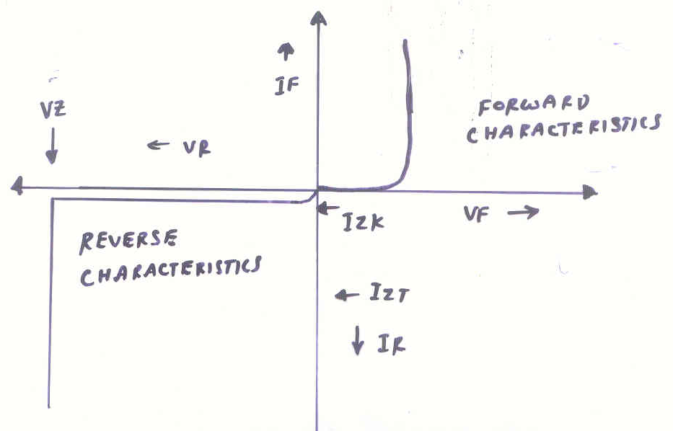
Characteristics of zener diode

Slide 44
Parameters of zener diode
Vz Zener break down voltage
IzT Test current for measuring Vz
IzK Reverse current near the Knee of the characteristics, the minimum current to sustain breakdown
VF,IF is Forward voltage and Forward current
VR,IR is Reverse voltage and Reverse current

